Slide 1
Deploying mobile learning assets

Slide 2
Text
Blogs
discussion or informational site published on the World Wide Web and consisting of discrete entries ("posts") typically displayed in reverse chronological order (the most recent post appears first)
Twitter
online social networking service that enables users to send and read short 140-character messages called "tweets
http://en.wikipedia.org/wiki/Blog

Slide 3
Blog
It is a form of a website
It is updated so often
Its articles appear in reverse-chronological order
It is frequently crawled by search engines
It covers a wide variety of articles
It is easily set up

Slide 4
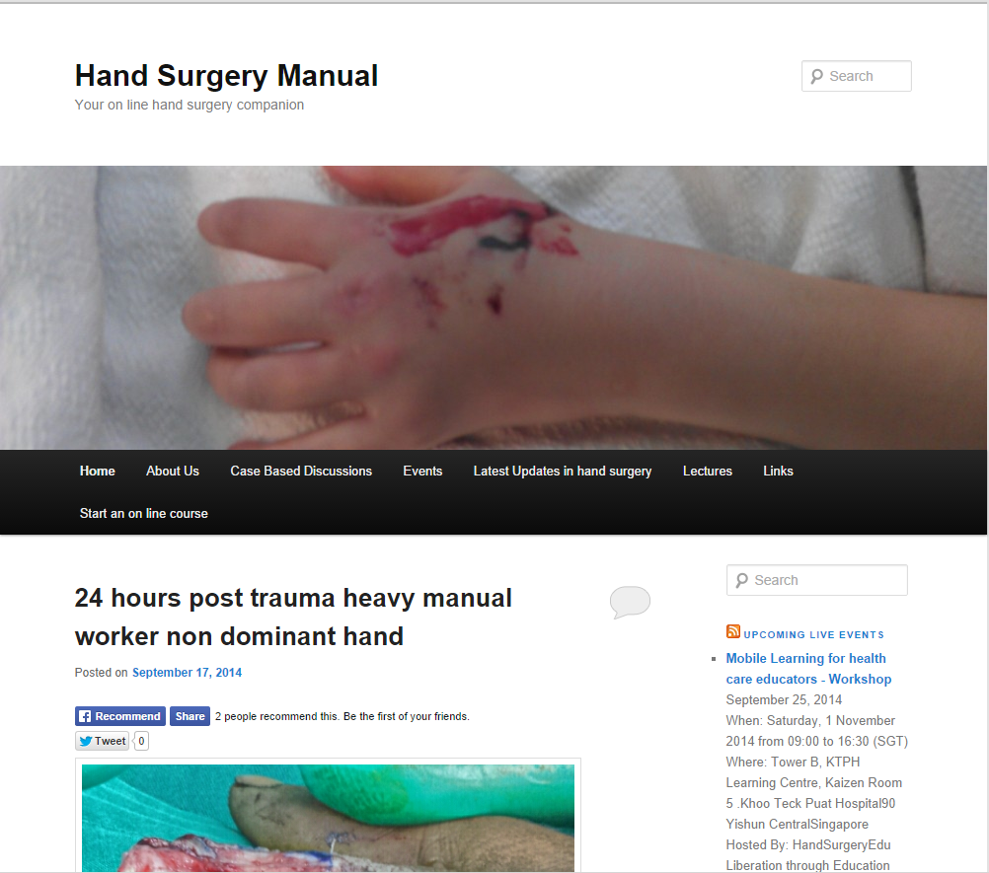
Blog platform
https://www.blogger.com
http://edublogs.org/
https://wordpress.com/

Slide 5
Twitter
Pointless babble – 40%
Conversational – 38%
Pass-along value – 9%
Self-promotion – 6%
Spam – 4%
News – 4%

Slide 6
How might we use Twitter for education?
Project brainstorming
Sharing online resources (internet sites)
Connecting to others around the world
Publishing or sharing links to published work.
Publicity for important events, blog posts, websites, podcasts, videos, live meetings/discussions, etc.
Twitter can serve as a resource to get help.
Twitter can serve as your support group when struggling with a difficult task.
Twitter provides a way to virtually attend conferences, workshops, conventions, etc. (via #hashtags).
Back channel during lecture (using event specific hashtags ie. #newtonfirstlaw) -- students can go back to Twitter to review, reflect, study key points shared
Back channel during videos/slideshows
Back channel during student presentations
http://twitterforeducation.wikispaces.com/Educational+Uses+of+Twitter

Slide 8
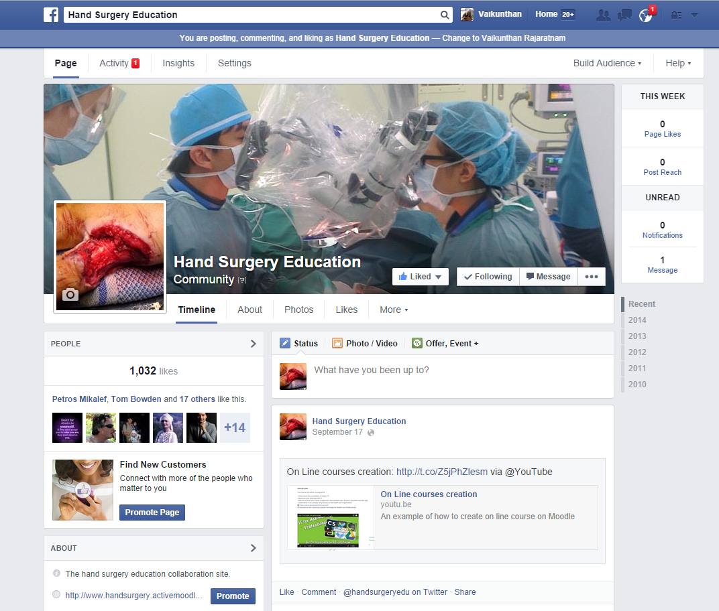
FACEBOOK
exchange messages, post status updates and photos, and receive notifications when others update their profiles.
common-interest user groups,

Slide 9
Advantageous
Relaxed, friendly and inviting atmosphere which encourages students participation and engagement
Students feel comfortable learning through Facebook because most of them use it everyday
Facebook can promote collaboration and social interchange between participants
Students get engaged about their learning outside the classroom

Slide 10
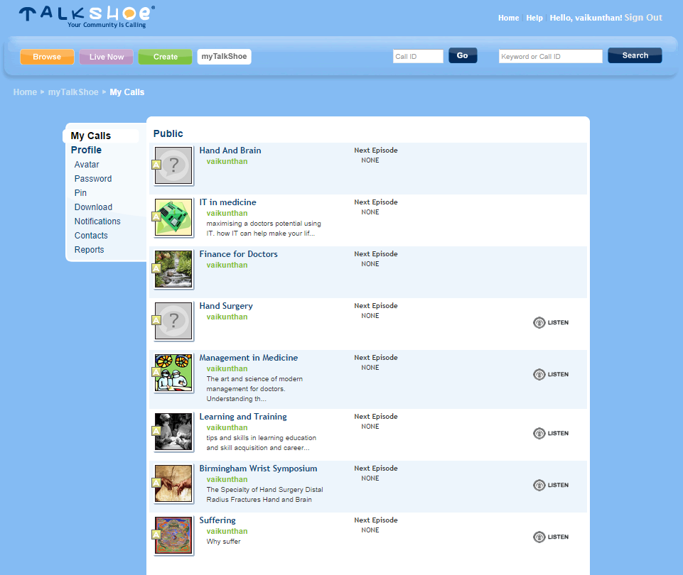
Voice
episodic series of audio, video, radio, PDF, or ePub files subscribed to and downloaded through web syndication or streamed online to a computer or mobile device.
http://www.podbean.com/
http://www.talkshoe.com/

Slide 11
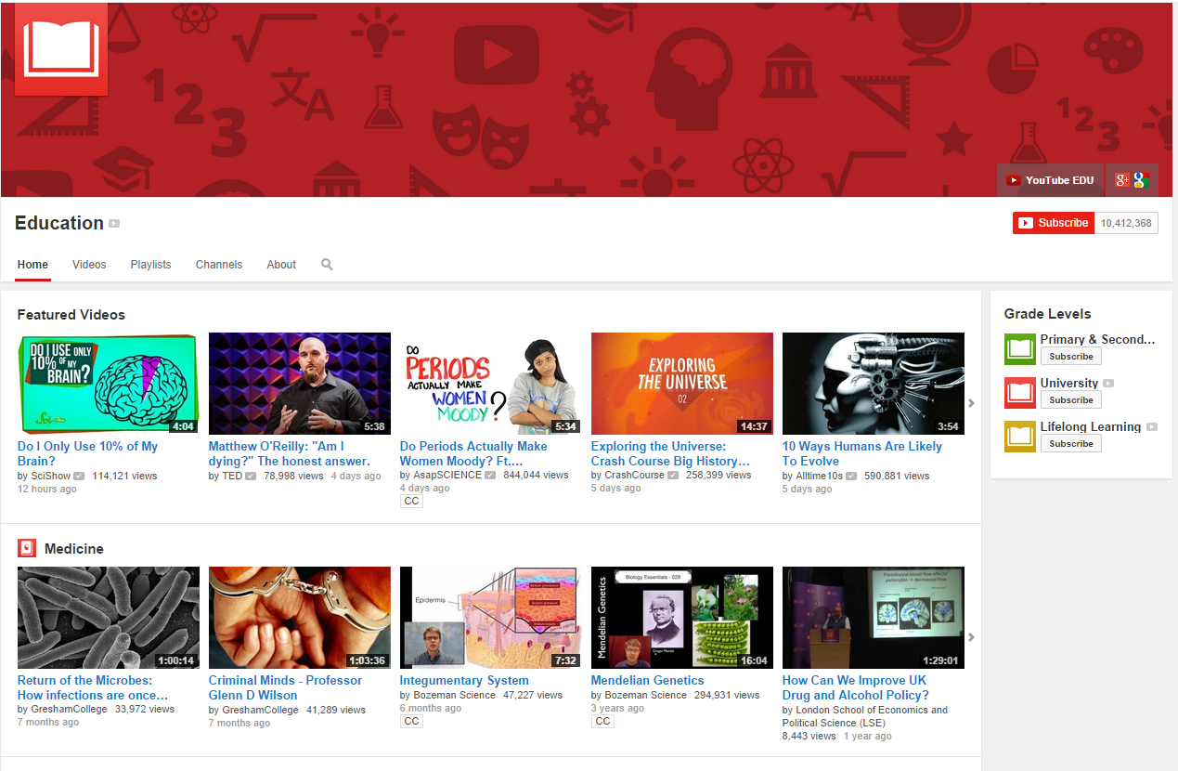
Video
YouTube
users to upload, view, and share videos, and it makes use of Adobe Flash Video and HTML5 technology
upload videos up to 15 minutes each in duration
1080p HD support
smartphones YouTube videos

Slide 13
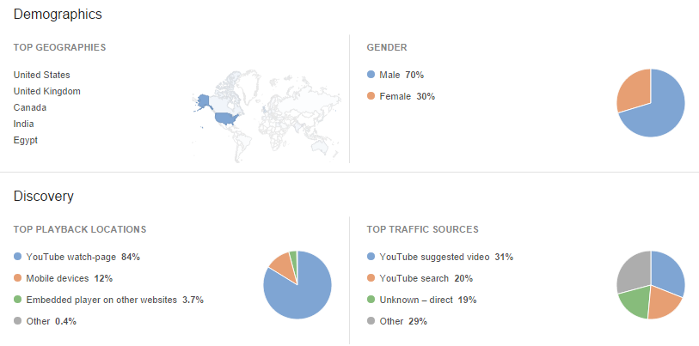

Slide 14
Real time analytics
30/09/2014 1813hrs

Slide 19
Interactions
Keyboard
Pen/touch
Hands free speech
Touch user interface are graphical user interfaces using a touchpad or touchscreen display as a combined input and output device. They supplement or replace other forms of output with haptic feedback methods. Used in computerized simulators
Gesture interfaces are graphical user interfaces which accept input in a form of hand gestures, or mouse gestures sketched with a computer mouse or a stylus

Slide 20
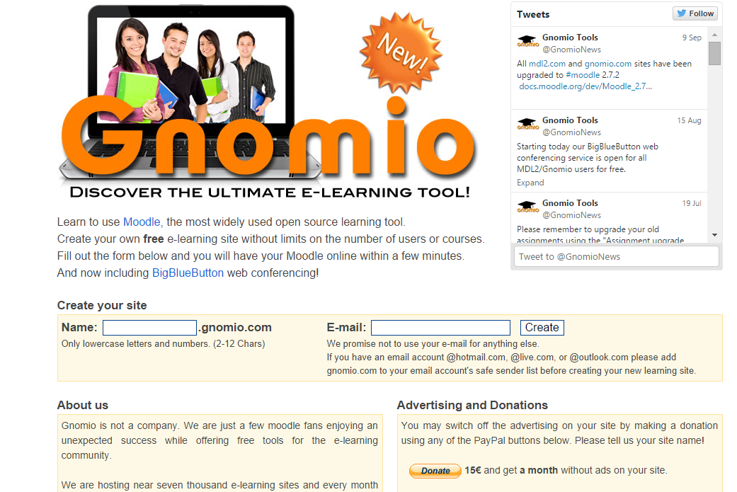
Learning Management Systems
Hosted vs Cloud based
SCORM vs Tin Can API
Free Moodle hosted service
Articulate Online is an easy way to host your Articulate content and track users results

