Slide 1
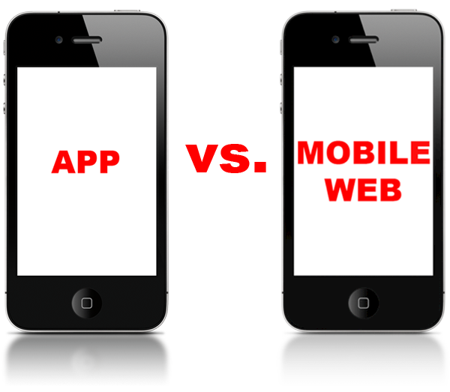
Mobile Website vs. Mobile App

Slide 2
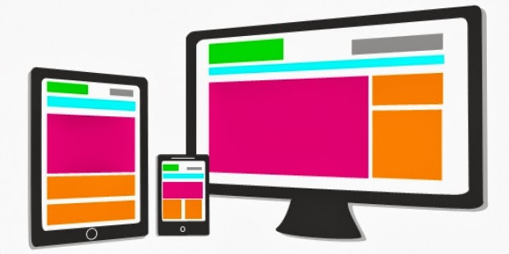
Mobile Web
Can be an App
Website designed for the
  smaller handheld display and
  touch-screen interface
  delivery of mobile-friendly content to the widest possible audience
  Instantly Available
  Compatible Across Devices
  Updated Instantly
  Found Easily
  Shared Easily
  Broader Reach
  Always there
  Easier and Less Expensive
  Support and Sustainability

Slide 3
App
applications that are downloaded and installed on your mobile device
may access, download and display content from the Internet
Interactivity/Gaming
Regular Usage/Personalization
Complex Calculations or Reporting
Native Functionality or Processing Required
No connection Required

Slide 4
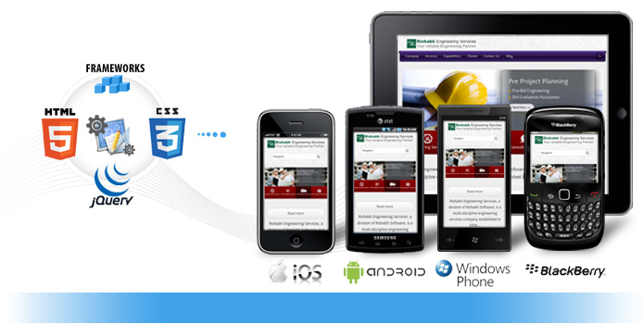
Mobile app -application software
designed to run on smartphones, tablet computers and other mobile devices
available through application distribution platforms
general productivity and information retrieval
http://en.wikipedia.org/wiki/Mobile_app

Slide 5
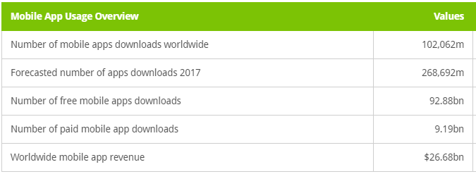

Slide 6
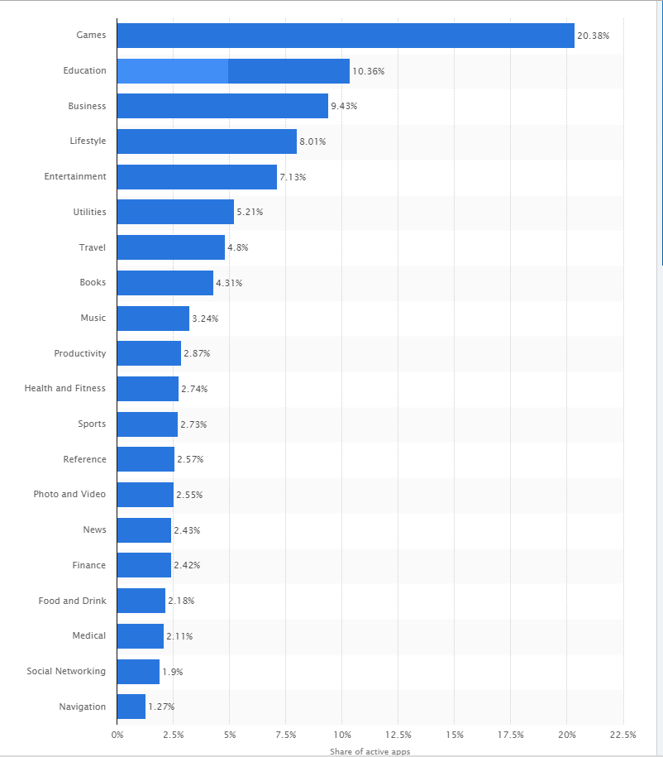
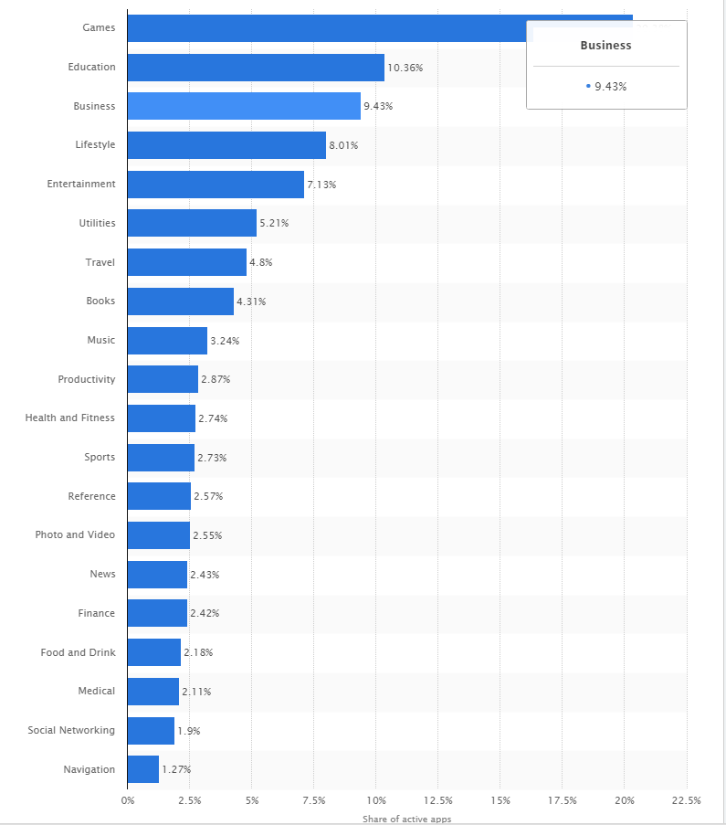

Slide 7
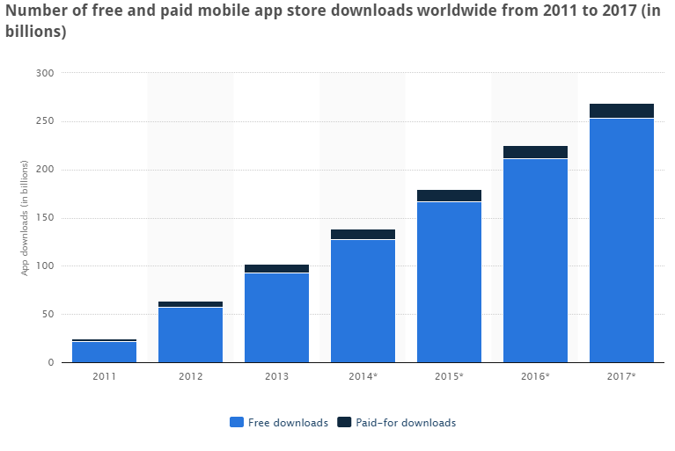

Slide 8


Slide 9
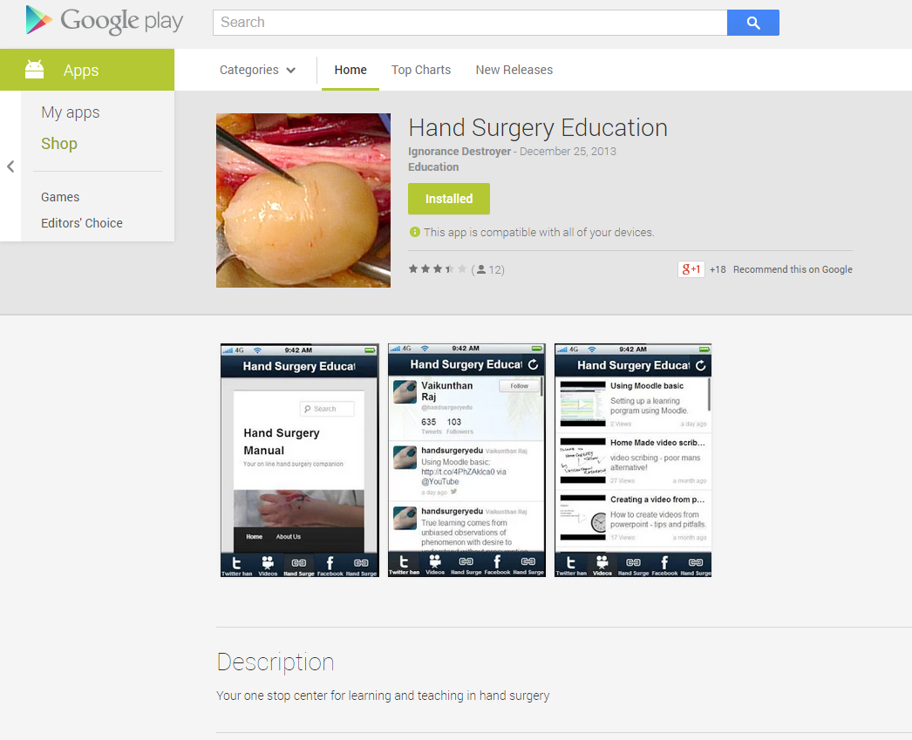

Slide 10
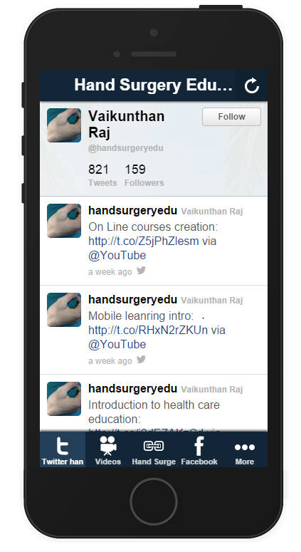
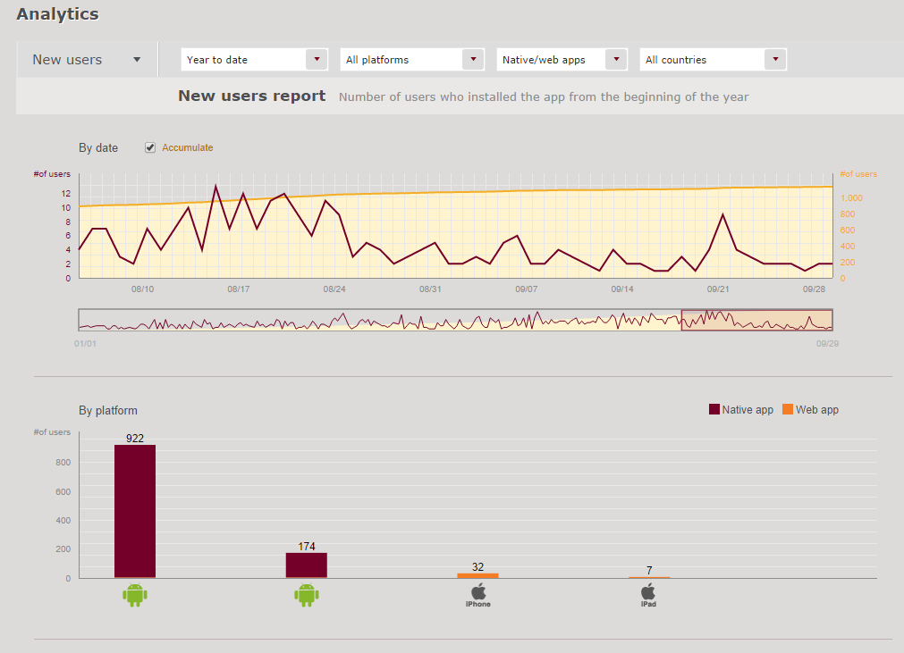

Slide 11
