Slide 1
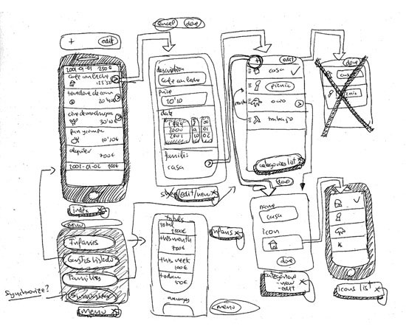
Introducing storyboards and wireframes

Slide 2
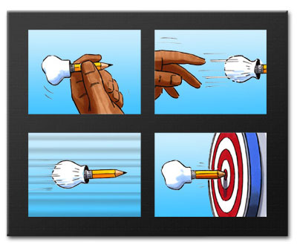
Storyboards
graphic organizers
illustrations or images
displayed in sequence
purpose of pre-visualizing
motion picture, animation, motion graphic or interactive media sequence.

Slide 3
8 steps for e learning storyboard

Slide 4
Each slide in a Storyboard Template must have
the Slide Number
Module Name
Topic Name
Learning Objective
Content ( Text + Images)
Notes to the Programmer/Designer ( detailing out your ideas on the kind of image or animation the slide must have)
Audio Script ( voice over for the slide)

Slide 5
details out each slide
right sequence
PowerPoint to make Storyboard Templates

Slide 6
Simple Storyboard Template for PowerPoint

Slide 7
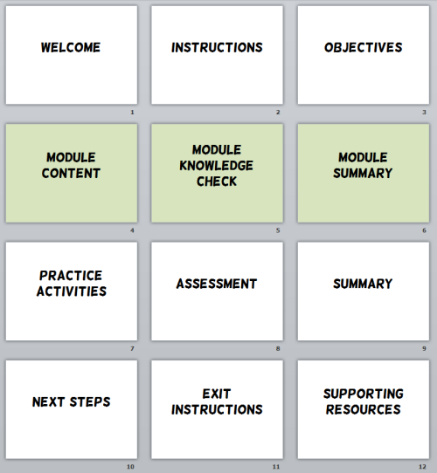

Slide 8
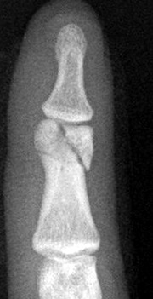
Splint K wire Lag Screw Plate External Fixator
27 year old non dominant index finger
IT technician and concert violinist
Beginning Previous Next Last

Slide 9
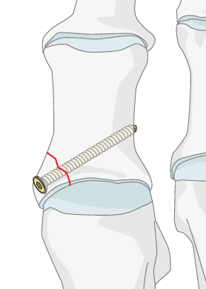
Splint
This is a possibility but will produce stiffness as it is intra articular fracture
General principle of intra articular fractures is
Anatomical reduction
Stable rigid fixation
Early mobilization
Reference 1
Beginning Previous Next Last

Slide 10
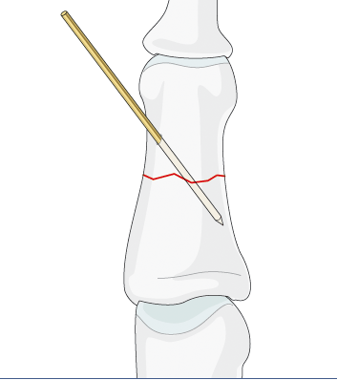
K wire
Will hold but not stable and also produce stiffness with the disadvantageous of surgery (scar, infection, bleeding and re surgery for removal)
less stable fixation
no compression possible
no early mobility
may separate the fragments
may irritate the skin
technically easy
minimal soft-tissue lesion
affordable cost
universal availability
Reference 2
Beginning Previous Next Last

Slide 11
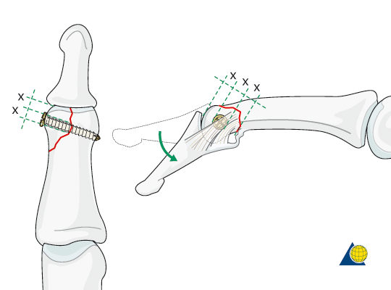
Lag screw
These fractures are rare, but difficult to treat. There is an increased risk of joint stiffness resulting from these fractures. It is wise to use magnifying loupes in these procedures. Gentle and precise handling throughout the procedure is mandatory.
Ideal Choice for the patient
Violinist need non dominant mobile painless finger playing action
articular fractures should be reduced anatomically
the articular cartilage may be damaged,
leading to painful degenerative joint disease and digital deformity.
can well be dealt with by arthrodesis, .
Reference 3
Beginning Previous Next Last

Slide 12
Plate
low incidence of malunion,
stable internal fixation
no need for external immobilization,
immediate movement of joints.
Meticulous surgical technique
Need training program
Beginning Previous Next Last
Reference 4

Slide 13
External Fixator
External fixation is an adequate alternative treatment for
unstable phalangeal and metacarpal fractures which are
open or accompanied by severe soft-tissue injuries.
External fixation provides an adequate basis for bone
healing, but does not guarantee good functional outcomes. These seem to depend on the severity of accompanying soft-tissue injuries
Reference 5
Beginning Previous Next Last

Slide 14
Reference 1
Beginning Previous Next Last

Slide 15
Reference 2
Beginning Previous Next Last

Slide 16
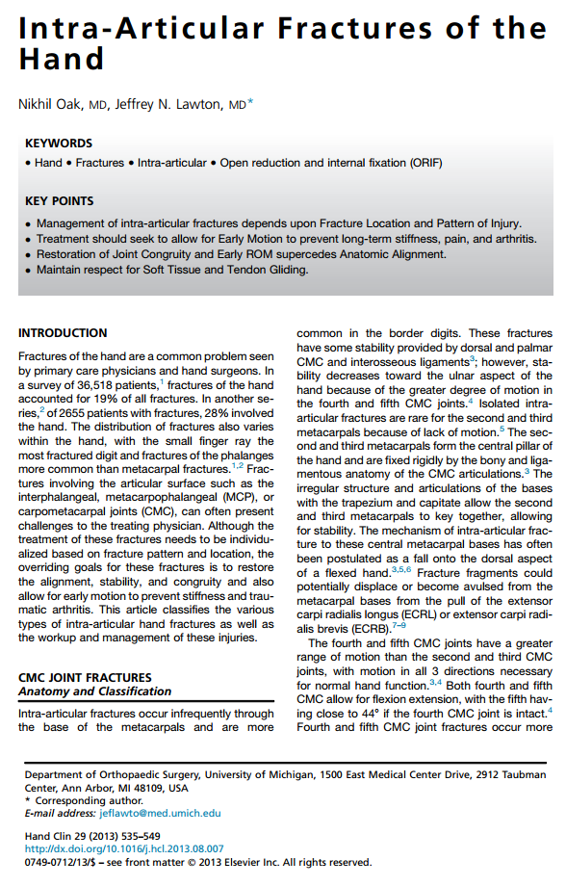
Reference 3
Beginning Previous Next Last

Slide 17
Reference 4
Beginning Previous Next Last

Slide 18
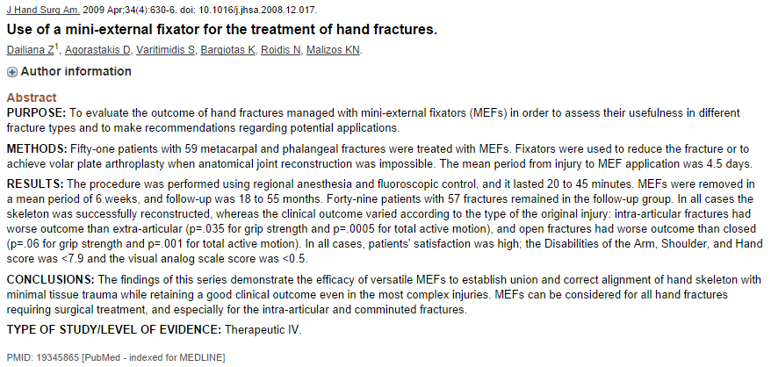
Reference 5
Beginning Previous Next Last

Slide 23
