Slide 1
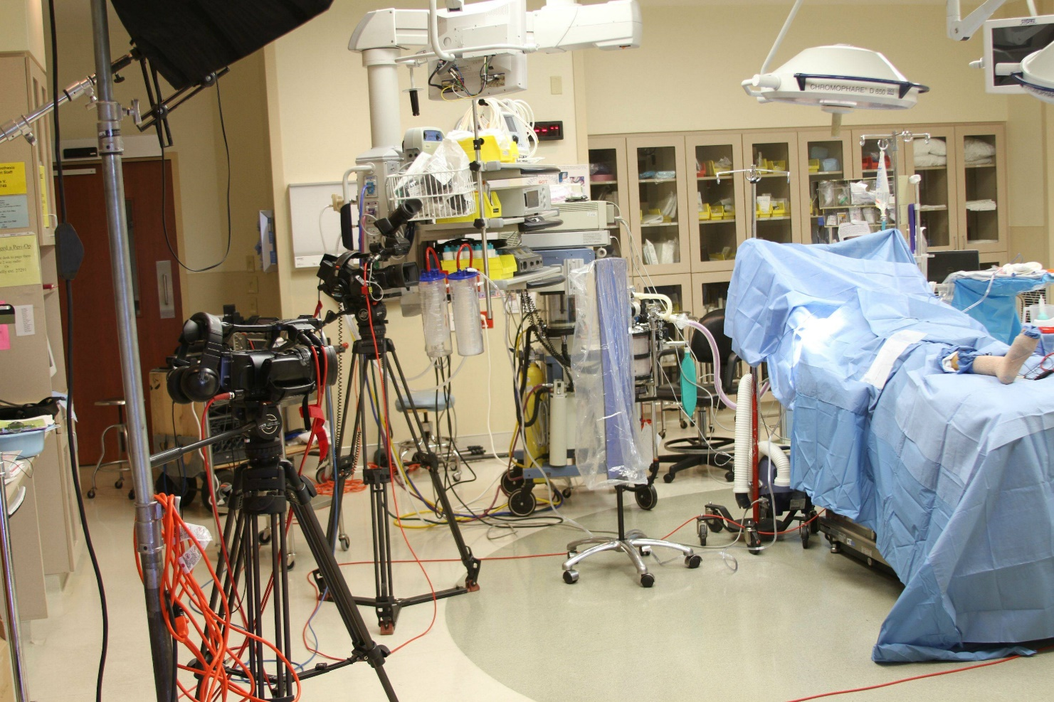
Health Care Educational Video Production

Slide 2
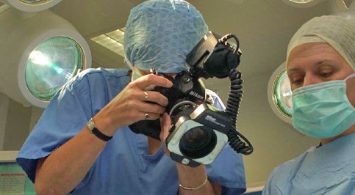
Video technology in education
powerful tool in motivating, engaging and instructing
transformability and transferability
enhance the learning experience
experiential value
demonstration of procedural activities
tool for self-reflection
As record of assessment

Slide 3
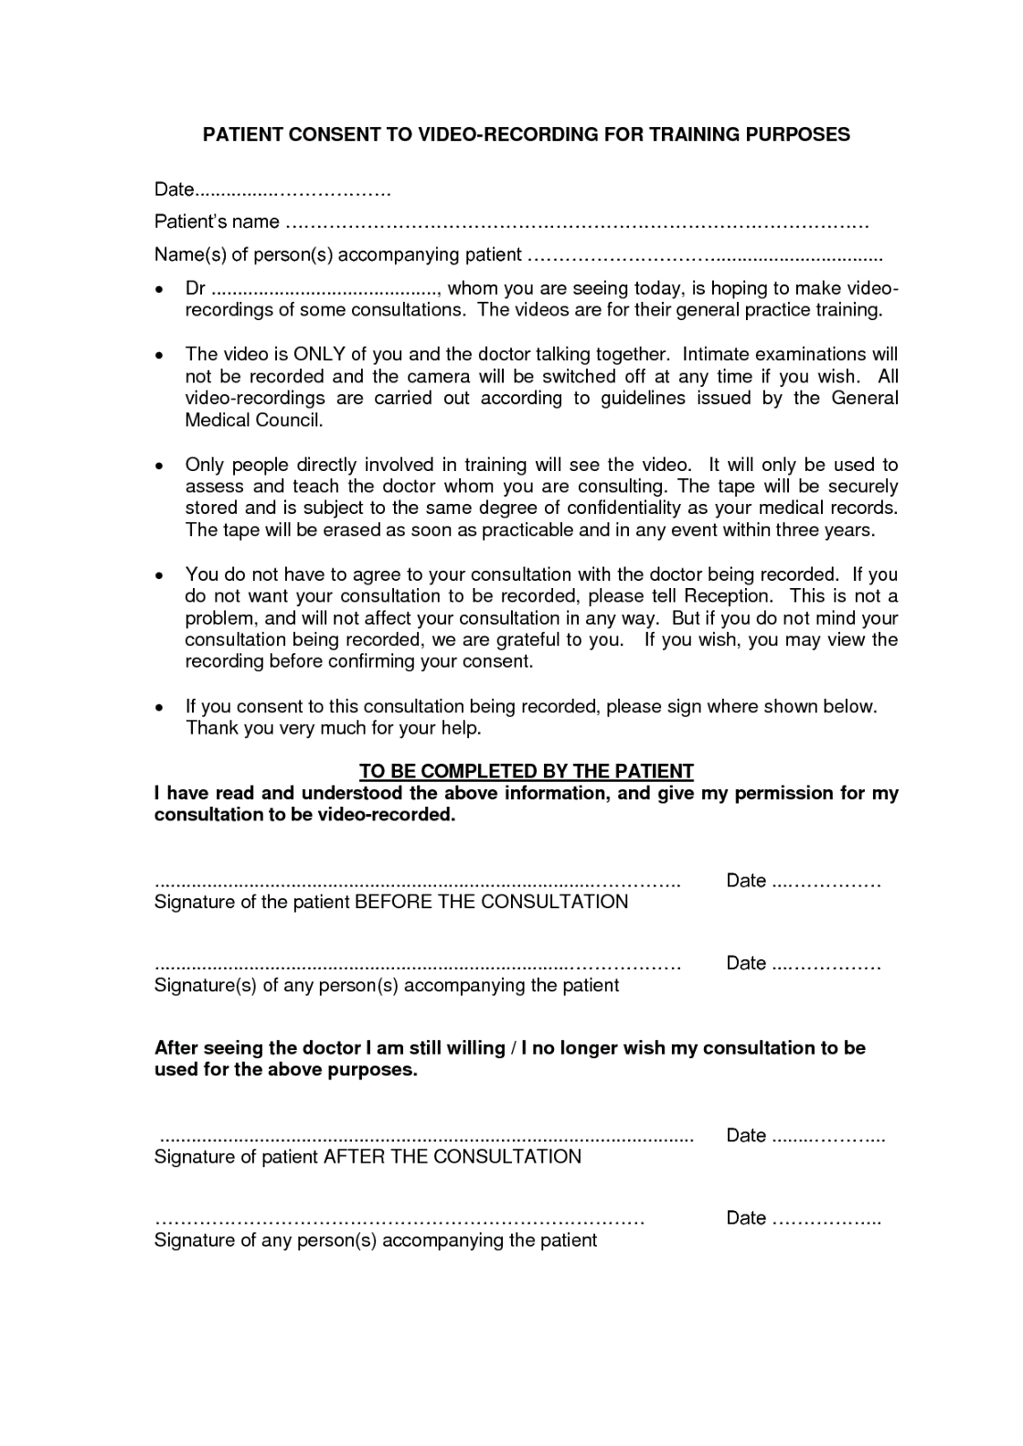
Consent

Slide 4
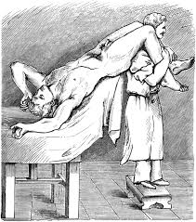
Exposure
Lighting
Perspective distortion
“plane parallel”
lens focal length
Management of Distracting elements
clothing (gowns), jewelry, make-up, hair, background
Standard views – consistency
establishing shot
close up detail shot
positioning
exposure
angle
Reproduction ratio
image size : actual size
technique – rock focus
Scale

Slide 5
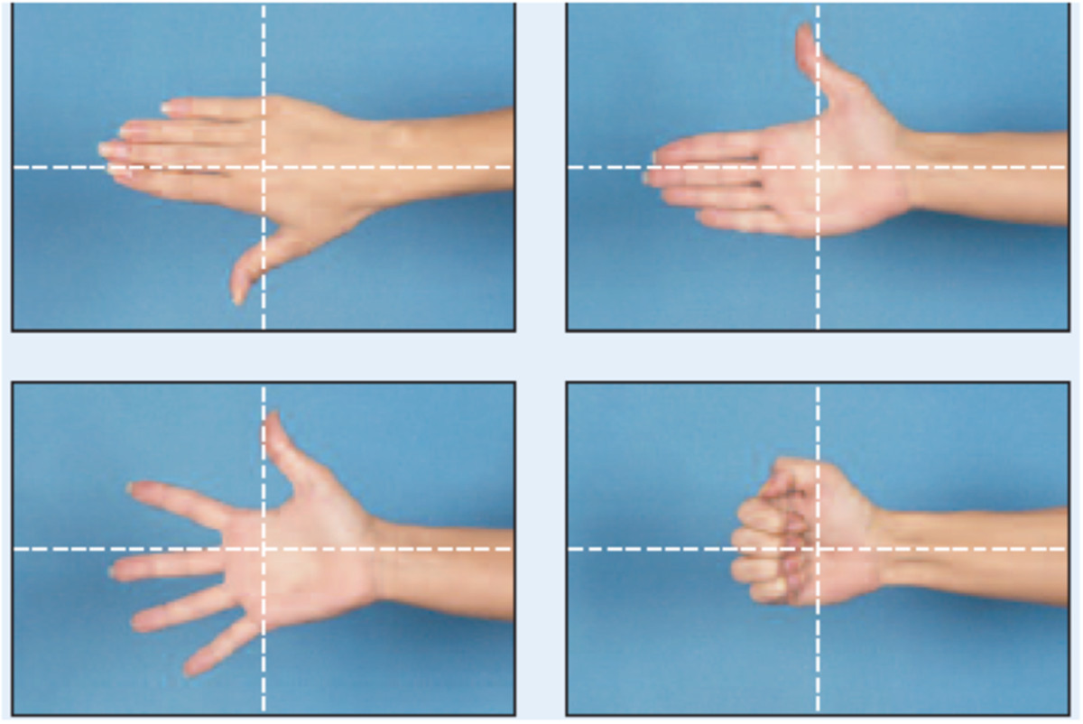
Hand
(a) Positioning: Patient should extend the finger being examined and place it next to tape marks that are perpendicular to the camera axis.
(a) Framing: Center hand in frame

Slide 6
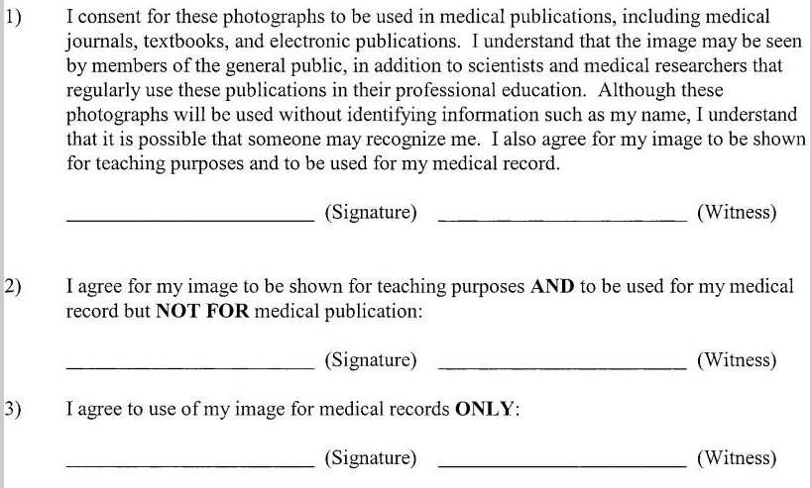

Slide 7
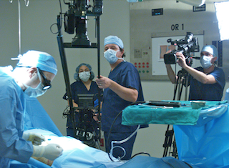
The Challenge -Educators vs Video Producers
video technology
editing software
process of video production
creativity and innovation
Technology – usability

Slide 8
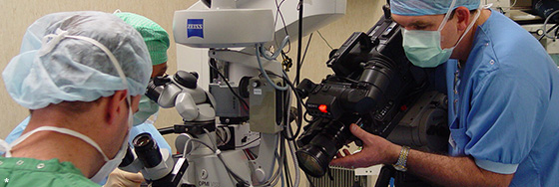
5 Steps to educational video production
Define the Content and the Educational Objectives
Decide the Pedagogic Approach
Decide the Context of Use and the Visual Format
Scripting and Storyboarding
Just do it - Produce
By Maria Manolopoulou

Slide 9
Define Content and Educational Objectives
directly connected with the curricula
Visualised content
key points
educational objectives - guideline to structure the video

Slide 10
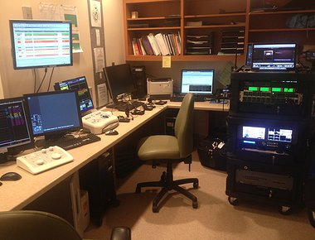
Pedagogic Approach
Open-ended
not obviously connected with the curricula and can seem somehow irrelevant as they have as a goal to motivate and engage students or
Instructional
structured "specifically designed to broaden and extend the experience of the learner"
produced for a specific use during a teaching task.
integrated with the
can achieve the learning objectives without further instruction

Slide 11
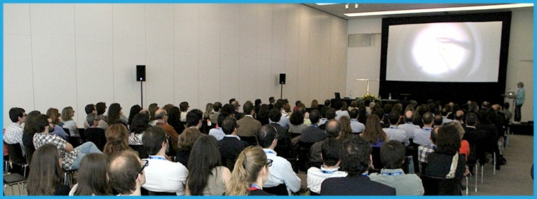
Context of Use and the Visual Format
How to use the video?
Is it going to be a part of a series, clips or video podcasts?
The visual format - the way that the educational content is delivered.
Presentation
Dramatisation
Interview
Demonstration

Slide 12
Scripting and Storyboarding
Write the script of your video
Story-boarding
visualize your thinking. Also, a storyboard act as a
guide for the producer and all the participants
storyline of your video

Slide 13
Scriptwriting
page into two columns
Decide what type of approach your video
Consider your audience
Consider the video's length
Write the way you speak
Use on-screen text to support what you say
Use music and special effects
Keep it simple.

Slide 14
Example of two-column script
VIDEO | AUDIO
Fade up to on-screen text: "Starting a Successful Oil Collection Program" | Music fades up, then under narration
Dissolve to shot of oil well pumping. | NARRATOR: Oil. Black gold. Crude. Whatever you want to call it, it's changed our world.
Dissolve to shot underneath a car, oil dripping into drain pan.
Cut to shot of traffic. Cut to plane taking off. | With it, millions of people can take to the roads or the skies for easy, quick travel.
http://edis.ifas.ufl.edu/wc024

Slide 15
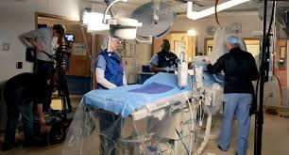
Produce
Direct on the set
Edit on the fly
Include background sound
video editing software
Music & Narration
transitions and graphics
Titling
Incorporate ppt

Slide 16
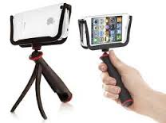
Video Equipment
Video camera:
HD
Wide screen
Ubiquitous – smartphone
Microphone:
lavaliere (also known as lapel or clip-on microphones),
hand-held, and
shotgun.
A light source
Natural lighting
reflector (a large silver screen)
artificial lighting.
Directional light
Diffused light
tripod / monopod
http://edis.ifas.ufl.edu/wc022

Slide 17
Video Shooting Considerations
Sequencing: "long shot" (wide shot), "medium shot" and "close up"
Continuity cut-ins and cut-aways.
Cut-aways: "cut away" from the action
Cut-ins: It's the same concept as cut-aways, ), you "cut in" to the video.
Jump cuts: These occur when a shot shows the same object in different angles or different locations Cut-ins and cut-aways and shooting shots that do not contain the "prominent person or object"
Shot length: record at least 8–10 seconds per shot.
On-screen text: consider where textual material will be placed
Logging video: catalogue or "log" the video that you shoot
Background noise or natural sound can add "flavour" & authenticity

Slide 18
Shooting Tips
Vary your shooting perspective.
Establish a shot sequence of long shot (establishing shot), medium shot, and close-up.
Don't shoot into a light source
If you are not shooting with a tripod, consider setting the video camera on a table
stop the camera with the record button before catching action in another area. .
If you are not a steady shooter and you don't have a tripod, shoot fewer close-ups.
Make pans, zooms, and tilts count. Only use pans, zooms, and tilts when they are called for

Slide 19
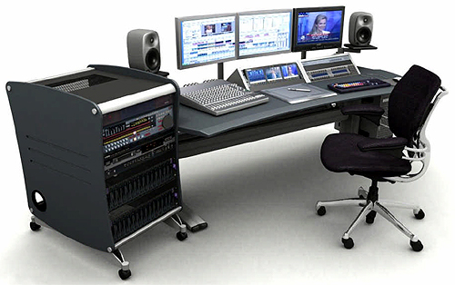
Video Editing
creative process
editing software programs digitize video
familiar with your video editing software
time-consuming
one minute of finished video takes one hour of editing time

Slide 20
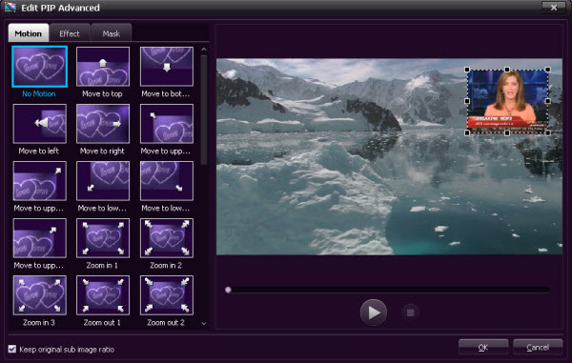
Video editing tips
Do not use everything you shoot.
Use, but do not overuse, video transitions
Cut, dissolve, fade, wipe
Properly pace the program.
Remember continuity.

Slide 21
Checklist for Producing Your Own Video
Practice with your video camera until you can operate it smoothly.
Secure proper video equipment: video camera, tripod, lights, and a microphone.
Minimize pans, tilts, and zooms.
Edit your video.
Duplicate and distribute your video to your target audience.

