Slide 1
Passionate about paper work
DMS

Slide 2
Document Management System (DMS)
track and store electronic documents (ED)
Create ED from hard copies
OCR for indexing
Archive and
Retrieve
Share

Slide 3
Creating
Scanning - CamScanner
Convert to machine readable document (OCR)
OneNote

Slide 4
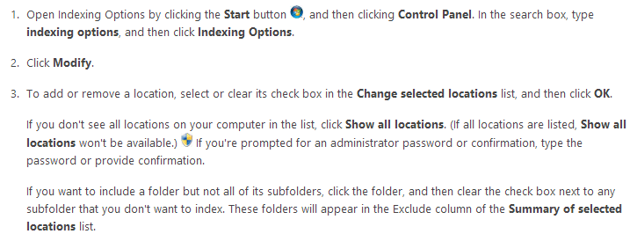
Indexing
Windows
Target drives/folders
Ensure OCR of scanned records

Slide 5
Archive
Zip doc
Reduce footprint
Cloud Computing

Slide 6
Search
Copernic Desktop Search
Windows Search 4.0

