Slide 1
Office 2010 update and alternatives – exploring its potential
Vaikunthan Rajaratnam

Slide 2
Overall aims
This lecture will cover
What an office suite is
Office 2010 and it capabilities
Alternatives to Office 2010
What are the pro and cons of each
Identifying their use in your clinical and personal life

Slide 3
At the end of this course you will be able
Describe an office suite and list the various components.
Be familiar with the potential use of Office 2010
List alternative suites and list the differences
Identify areas in clinical and personal life for their use

Slide 4
A office suite
collection of productivity programs intended to be used by knowledge workers. The components are generally distributed together, have a consistent user interface and usually can interact with each other, sometimes in ways that the operating system would not normally allow.

Slide 5
Components
Word processor
Spreadsheet
Presentation program
Database
Graphics suite (raster graphics editor, vector graphics editor, image viewer)
Desktop publishing software
Formula editor
Diagramming software
Email client
Communication
Personal information manager
Notetaking program
Groupware
Project management software

Slide 6
Office 2010
productivity suite for Microsoft Windows
Office Professional 2010
Includes: Word | Excel | PowerPoint | Outlook | OneNote | Publisher | Access |
Office Professional Plus 2010
Includes: Word | Excel | PowerPoint | Outlook | OneNote | Publisher | Access | InfoPath | SharePoint Workspace | Communicator.

Slide 7
What’s new
the Ribbon, a graphical system that groups buttons for common tasks together in tabs
Backstage View - one-stop for information about documents and common tasks as saving and printing files
photo editing tools, via Ribbon
Quick Steps, mail handling -Right-click on a message, and you can choose from a variety of actions

Slide 8
Word
Search - charts, tables, footnotes and other content. -opens as a left-hand pane, with options for narrowing the search
Screen Clipping option, which allows you to take a screenshot anywhere in Windows and insert it into your document.
sophisticated typography
Document sharing -multiple people able to work on a document simultaneously online

Slide 9
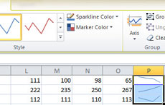
Excel
"Sparklines" -- small cell-sized charts -quick visual representation of the data.
sharing data with other people, including multiple people working on a document at a time

Slide 10
PowerPoint
basic video editing tools
video controls you can use during the presentation
embed videos from online video-sharing sites such as YouTube
more animations to choose from

Slide 11
Access
Web-ready database format
Macros
Themes
Groups of fields – quickstart
Reporting
Expression and Query Builder use Intellisense

Slide 12
Outlook
The ribbon
Backstage View
Conversation Management
Calendar Preview
Quick Steps
People Pane
Mailtips

Slide 13
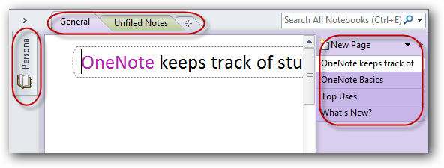
OneNote
free-form information gathering and multi-user collaboration
organizes your notes in Notebooks
enter text, pictures, and more anywhere on a page
create ink notes
powerful OCR
installs a virtual printer, so you can send info from any program to OneNote

Slide 14
Publisher
Improved templates
Office Backstage
Save Files As PDF Or XPS
Enhanced Photo Editing Features
Easy Targeted Emailing
Integrated Print Properties
Catalog Merge

Slide 15
Research
Pubmed/Athens/Scopus
Google scholar
Collaboration – cloud, google docs
Survey – google survey
Researchgate

Slide 16
Alternative suites
Free
Open office
LibreOffice
Calligra Suite
Premium
Lotus Symphony
EasyOffice

Slide 17
Application
Clinical work – correspondences, EMR, scheduling, marketing, accounts,
Teaching – instructional objects,
Research – database, imaging, logic function excel
Personal – PIM, hobby,

