Slide 1
The basics of computing - What system do you need?
Vaikunthan Rajaratnam

Slide 2
Overall aims
This lecture will cover
How IT is used in medicine
Basic systems that are available
What are the pro and cons of each
Identifying your needs

Slide 3
At the end of this course you will be able
The role of IT in medicine from practice, learning and research perspective.
to understand the Windows, Mac, Linux and Chrome OS systems and their pro and cons
How to identify your needs and what system best suits your needs
Describe What is the future in computing and medicine

Slide 4
IT in Medicine
Clinical
Education
Research
Personal management systems
Contacts, calendar, document management systems, finances, databases, multimedia, e learning
Communication
Collaboration

Slide 5
Clinical
Patient administration system
Xrays,
EMR,
scheduling,
communication,
tele medicine,
robotic medicine,
diagnosis,

Slide 6
Education
Personal CPD – learning portfolios/journals
Teaching
Podcast , video cast, blogs, Facebook, Twitter,
Search engines
Authentic educational sites - HON

Slide 15
Research
Pubmed/Athens/Scopus
Google scholar
Collaboration – cloud, google docs
Survey – google survey
Researchgate

Slide 17
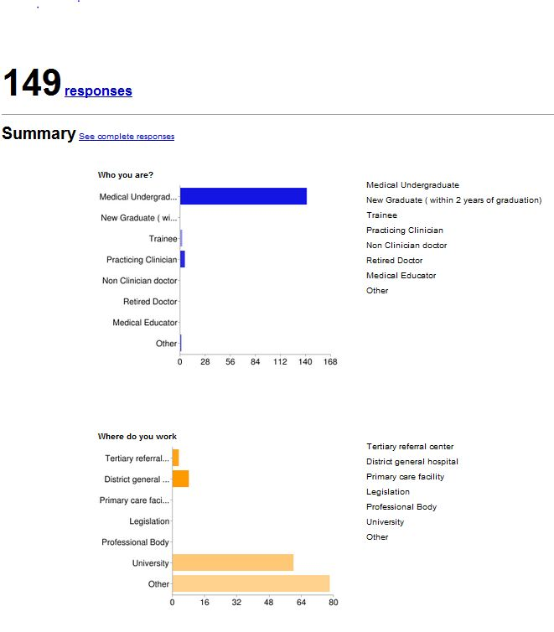

Slide 18
Personal Management System
PIM – Microsoft suite, Google
Document management system –Scan, OCR, file, index, search, cloud computing
Finances – banking, investment, budget, expenses, accounts
Database – patient records, research, hobbies
Media – image, video, audio, animation
E learning objects

Slide 19
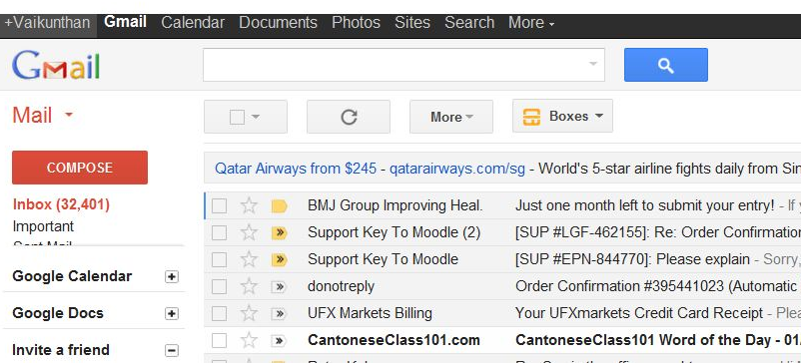
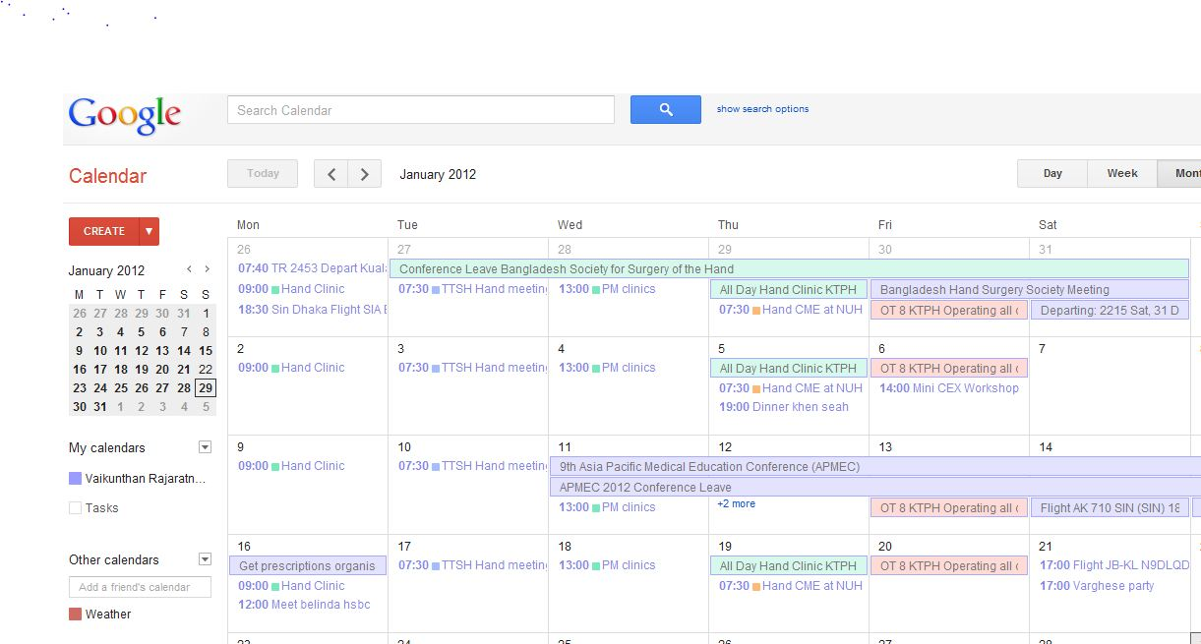
PIM

Slide 20
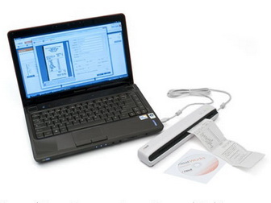

Slide 21
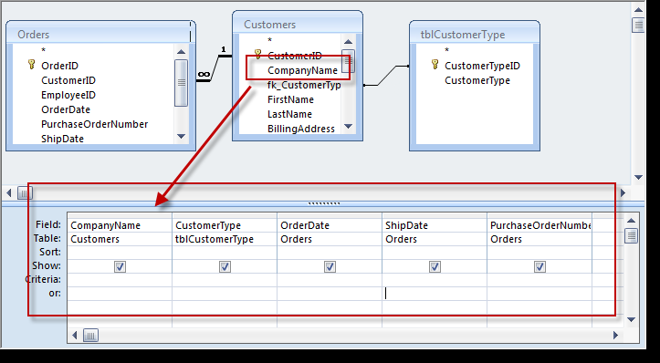
Database

Slide 22
Media
Picassa
Youtube
Audacity
Window media
Xtranormal

Slide 23
E learning
PowerPoint 2010
Course Lab
LCDS
Articulate

Slide 24
Communication
Skype
WizIq
Viber
Tango
Google +

Slide 25
Collaboration
Cloud
Google docs
Dropbox
Prezi
Writeboard

Slide 26
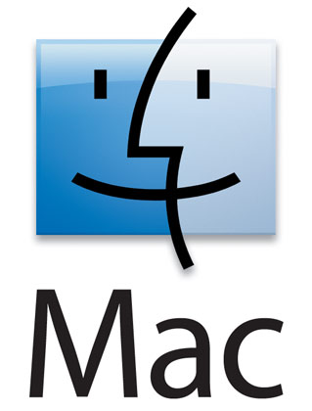
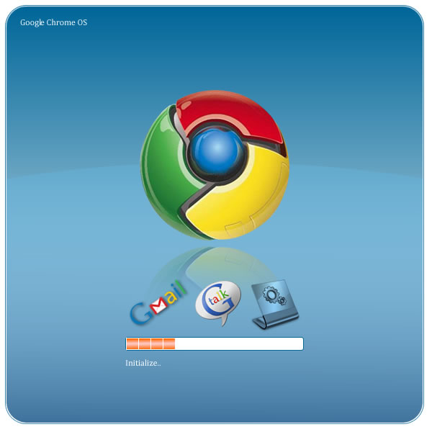
What system

Slide 28
Windows users
Home office users
IT Professionals
Developers
Business owners
Schools
Hospitals
Banks

Slide 29
Mac Users
Home Office users such as authors & lawyers
Start ups such as Twitter & Monster Designs
Accountants such as Nelson Accounting Professionals
Architects such as KAA Design Group
Creatives such as LinkedIn, T-Pain, Hallmark, and Francis Ford Coppola
Health industries such as hospitals
IT professionals such as MailWise
Law firms
Real Estate agents
Retail stores such as Paul Frank
Scientists such as The University of Manchester and The American Museum of Natural History

Slide 30
“Mac vs PC People: Personality Traits & Aesthetic/Media Choices“
Mac People - the existing world in a light of “sameness” and thus express a desire to be perceived as different and unique. …in their aesthetic choices such as bold colors, “retro” designs, one-of-a-kind clothing and highly stylized art.
PC People - the world as “different enough already” and appreciate “being in tune with those around them.” - subtler, “mainstream modern” (neither retro nor extremely contemporary) design choices and their practical choices in clothing, footwear, and cars that favor getting the job done rather than making an overt design statement.
Media choices - Mac People trending toward more independent films, specialized comedians and design-centric magazines, and PC People trending toward more mainstream alternatives as well as sports.
Mac People ..describe themselves as “verbal”, “conceptual”, and “risk takers”, PC People ..are “numbers oriented”, “factual” and “steady, hard workers”.

Slide 31
Future
TECH TRENDS
Push media is back
news and information downloaded automatically
teens are so over e-mail
E-mail use is dropping fast among teens – What’s App
Surfing the Web with nothing but brainwaves
Kiss your keyboard goodbye

