Slide 1
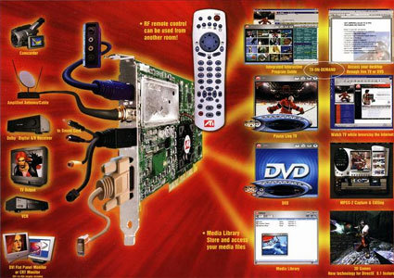
MMC – Multimedia confusion – beyond PowerPoint - imaging , video and audio in medicine

Slide 2
PowerPoint

Slide 3
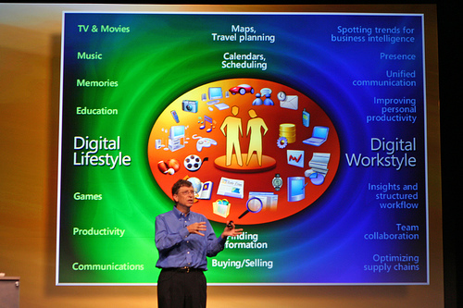
Presentations
Ppt
Acrobat PDF file from the "print handouts"
convert to Flash/Video
Screencast

Slide 4
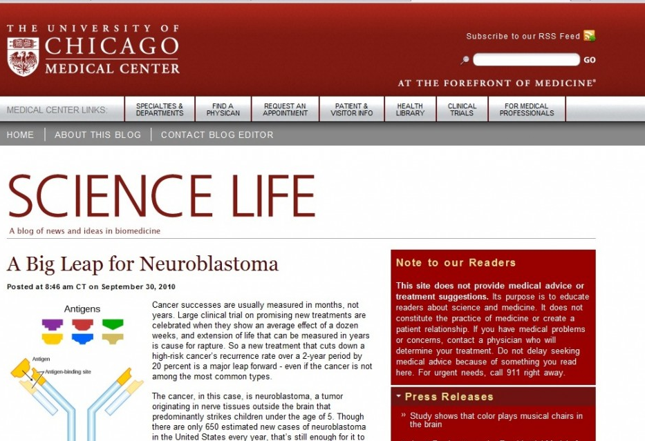
Blogs and Wikis
write web pages simply using a web browser
consensus documents
reflective writing
Wordpress
E.g., blog

Slide 5
Podcasting and Video casting
MP3 audio files
“screencast” presentations
Podbean etc
20,000km/yr of driving = UG degree in 1.5yrs!
Video vs Audio

Slide 6
http://web2-0world.wikispaces.com/Podcasting

Slide 7
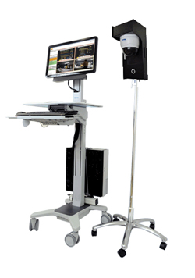
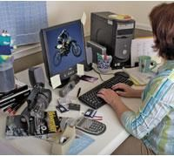
Digital Video
QuickTime, Windows Media/AVI, Flash, RealVideo and MPEG
HTML5
Simple editing on the fly

Slide 8
Web Conferencing
Wiziq
Skype

Slide 9
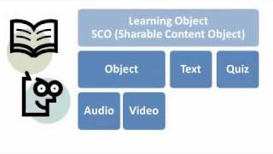
E learning objects
Sharable Content Object Reference Model (SCORM) compliant
set of technical standards for e-learning software products
electronically supported learning and teaching

Slide 11
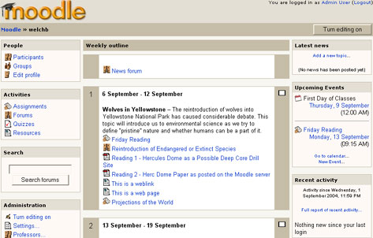
LMS
Moodle
MBA, Hand Surgery

