Slide 1
http://today.io/ttDR
Today’s Objectives

Slide 2
Mobile Learning and Medical Education

Slide 3
In-Class/Backchannel Discussion
What if medical schools were designed with _____ in mind?
What if medical schools abolished _______ altogether?

Slide 4
What is Mobile Learning?
"learning across multiple contexts, through social and content interactions, using personal electronic devices.”

Slide 5
http://wearesocial.net/tag/europe/

Slide 6
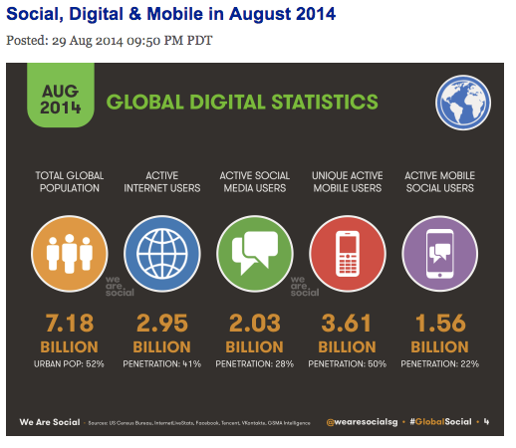

Slide 7
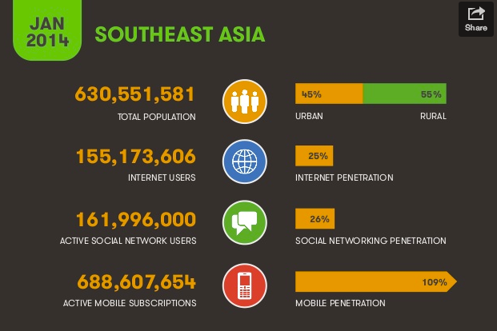

Slide 8
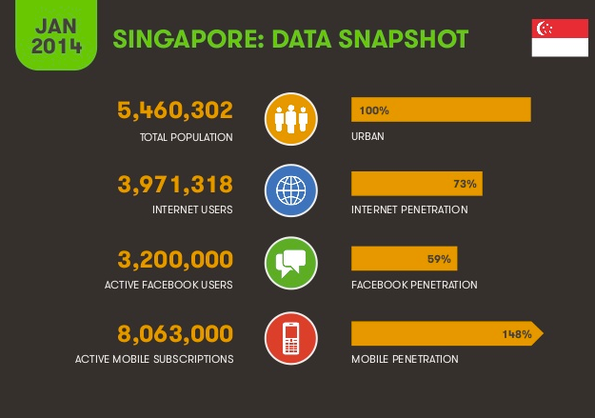

Slide 9
How much time do you spend on your devices per day?

Slide 10
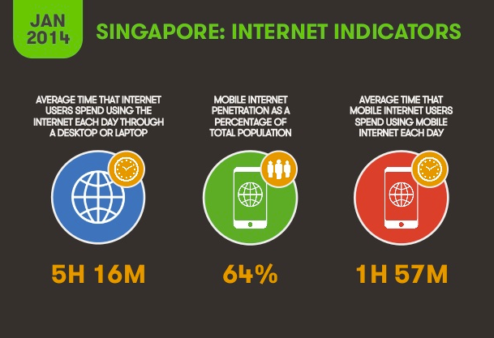

Slide 11
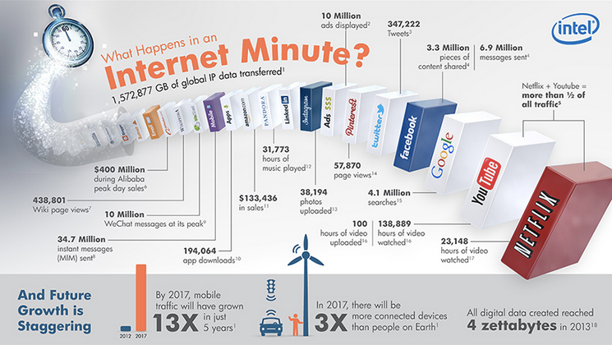
Internet Minute Graphic

Slide 12
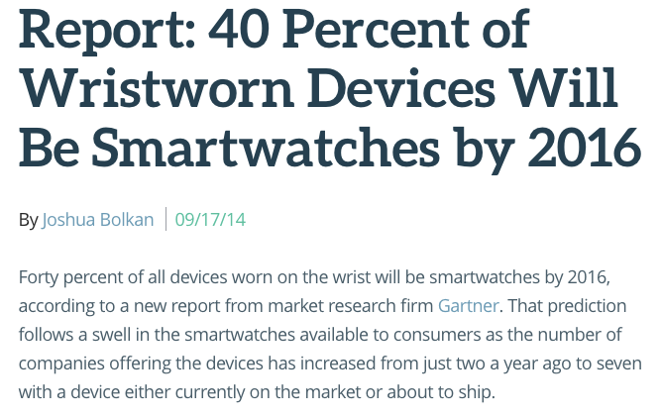

Slide 13
2017...
Cisco Visual Networking Index: Global Mobile Data Traffic Forecast Update, 2012–2017
By 2017 there will be nearly 1.4 mobile devices per capita.
There will be over 10 billion mobile-connected devices in 2017.
Mobile network connection speeds will increase 7-fold by 2017.
In 2017, a 4G connection will generate 8 times more traffic on average than a non-4G connection.

Slide 14
Why Do We Need Mobile Technology in Teaching?
1- Accessibility
2- Power
3- Engagement

Slide 15
Teaching and Learning
Not about what we can teach, it is about how we teach it more effectively

Slide 16
Teaching and Learning
1- Communication
2- Production vs. Consumption of Content
3- Evidence of Learning
4- Collaboration
5- Reality

Slide 17
And now…

